Slide 1
Fitness Assistant
Team: Aishwarya and Uddaraju Varma
Team lead: Kishor Parida
Manager: Vipin Yadav

Slide 2
INDEX
What is Fitness Assistant?
How it is built?
Features of Fitness Assistant
Workflow
Architecture of Fitness Assistant
Advantages of Fitness Assistant
Working/ Demo

Slide 3
What is Fitness Assistant?
The main aim of this Fitness Assistant is to make its users active, fit, and healthy. For this, it offers personalized fitness training that can be done anywhere anytime. It turns your smartphone into a personal fitness trainer, that utilizes media pipe to track your fitness techniques.

Slide 4
How it is built?
We have used Flask web framework to build this web app .
Face recognition module for face login.
Socketio and zmq for communicating between the processes.
Mediapipe to track the exercise .

Slide 5
Features :
Face login for the web app
Food intake form
Demo of Exercise
Ip Webcam provision
Tracking the exercise with proper posture
Automatic redirection from one exercise to other with a wait timer

Slide 6
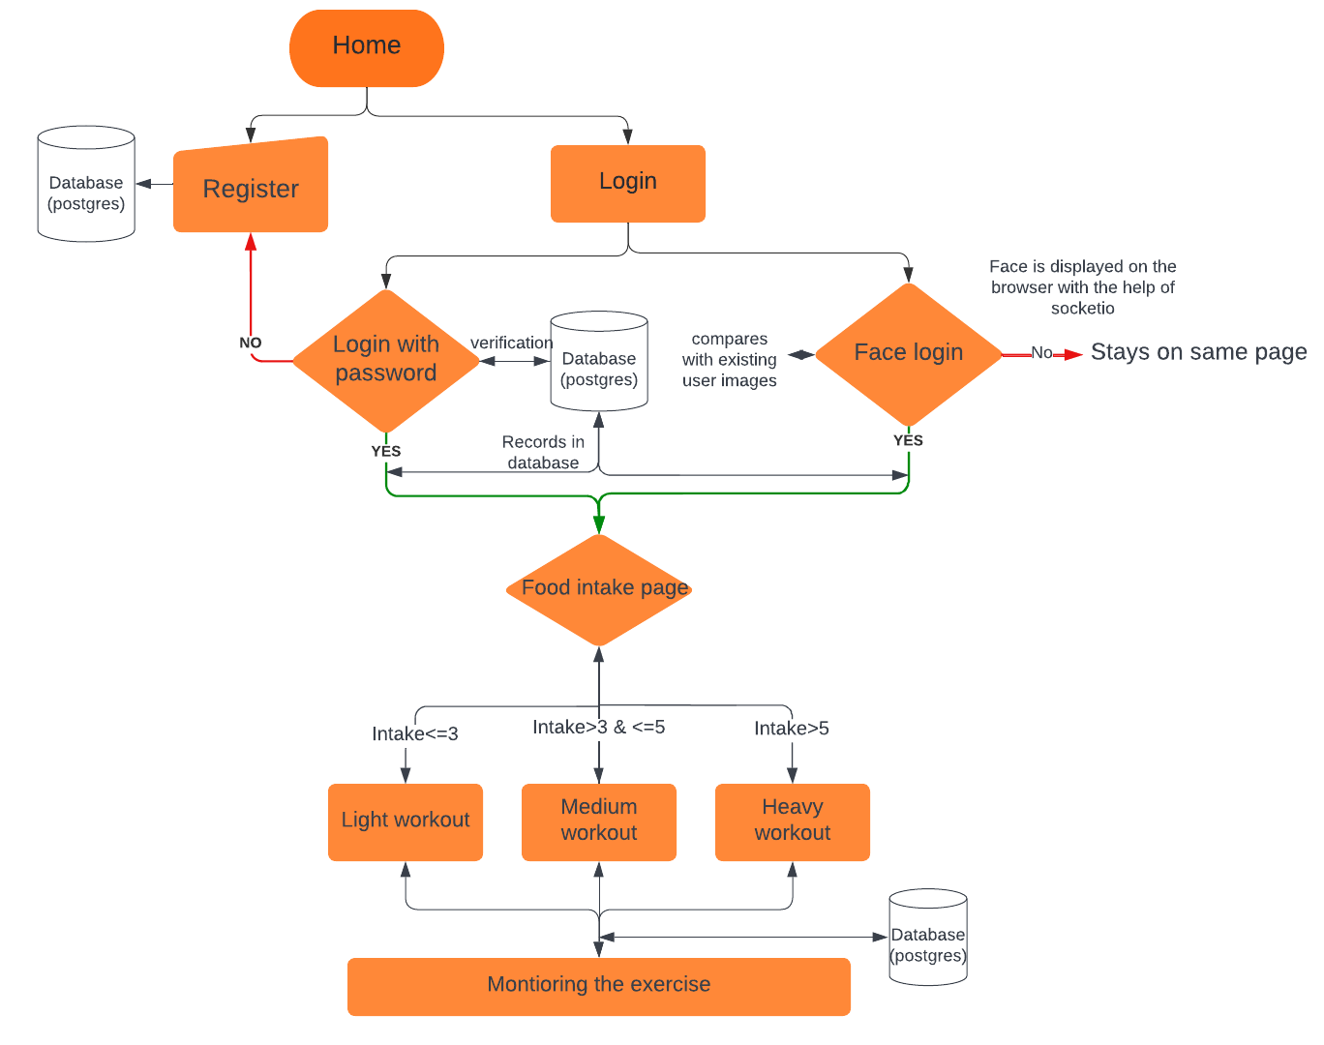
Flowchart

Slide 7
Data flow architecture:
Source-IP webcam
(video feed )
base_64
frames
client
Base_64
(zmq)
Server
(detections using media pipe)
Base_64
(socketio)
UI page

Slide 8
Advantages of Fitness Assistant:
Personalized exercise recommendation
Workout anytime anywhere
It's often far more accessible than a personal trainer, which simply makes it easier to get the information you need without having to rely on another human being or keep up with the sometimes extortionate payments.
The sad and annoying truth is that highly qualified personal trainers are often quite expensive. For those who want to achieve their fitness objectives, fitness-based applications powered by artificial intelligence can offer the perfect alternative.

Slide 9
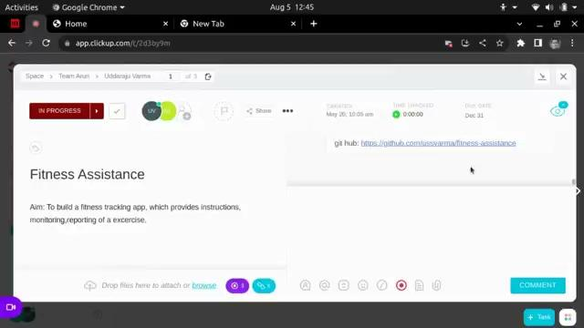
Demo:

Slide 10
Thank you

Slide 11
Questions and Suggestions

Slide 12
Data flow architecture:
ZMQ
Front end
(socketio triggers)
socketio
CLIENT
SERVER
1. Socketio event listens
2. Generates video frames
and sends to server
3. Accepts detected frames and pushes them to front end part
1. Accepts the video frames from
client
2. Does detections
3. Sends back the detected frames
to client.

